Slide 1
The Author-topic model for authors and
Team Doctrina Apparatus

Slide 2
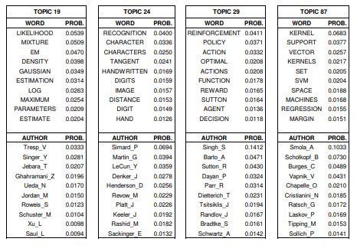
Author-topic model
Introduction
This model provides simple probabilistic model for exploring the relationships between authors, documents, topics and words.
Topic is defined as probability distribution over words and is discovered automatically with unsupervised learning.
At the same time, author’s interest to that topic is simultaneously quantified.

Slide 3
Topic model and author model

Slide 4
Model description

Slide 5
Parameter estimation by Gibbs sampling
Baysian Method
Markov Chain
1000 iteration

